Slide 1
AISHIP: An Ontology for Extended Vessel Representation and Multimodal Data Integration
Simon Burbach, Lennart Mackert, Maria Maleshkova
Data Engineering
Helmut Schmidt University
Notes:
All in all: ODPs to model
units according to QUDT
Trajectories acoording to VesselAI

Slide 2
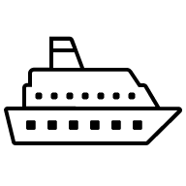
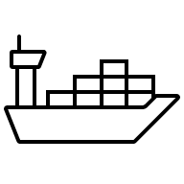
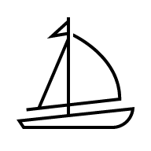




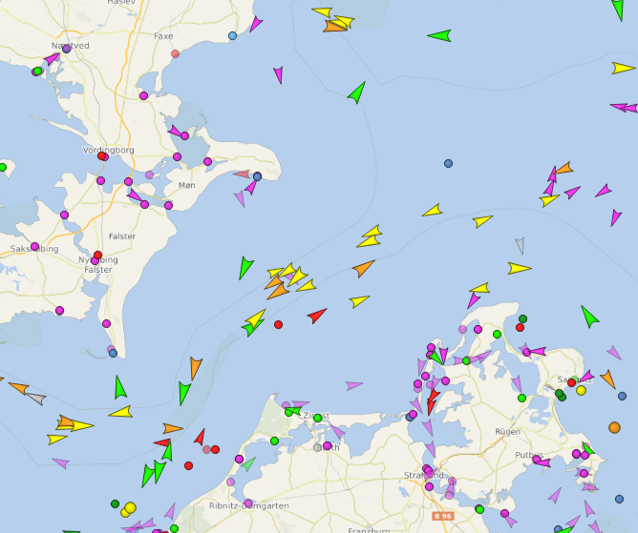
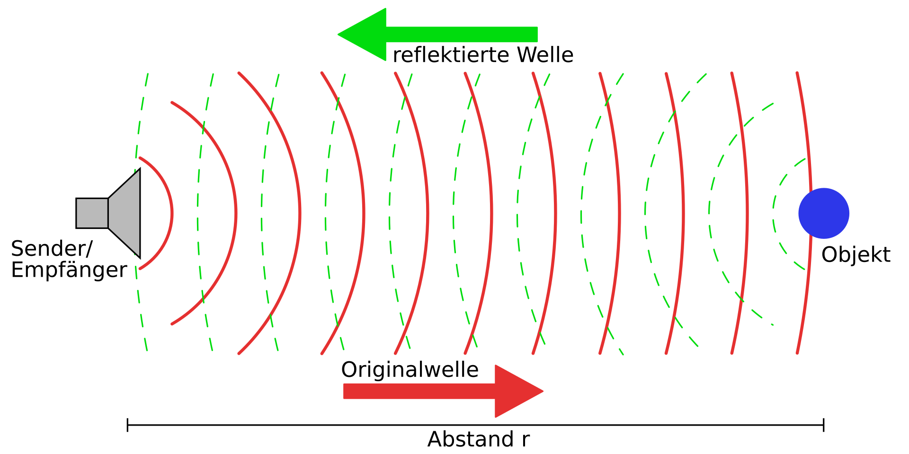
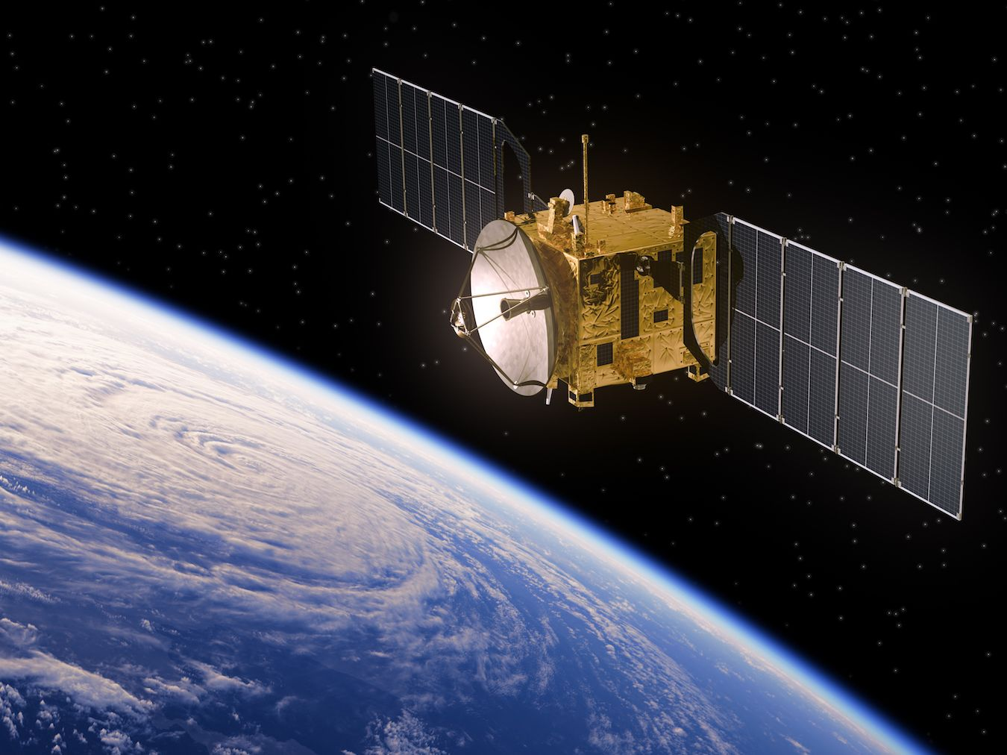
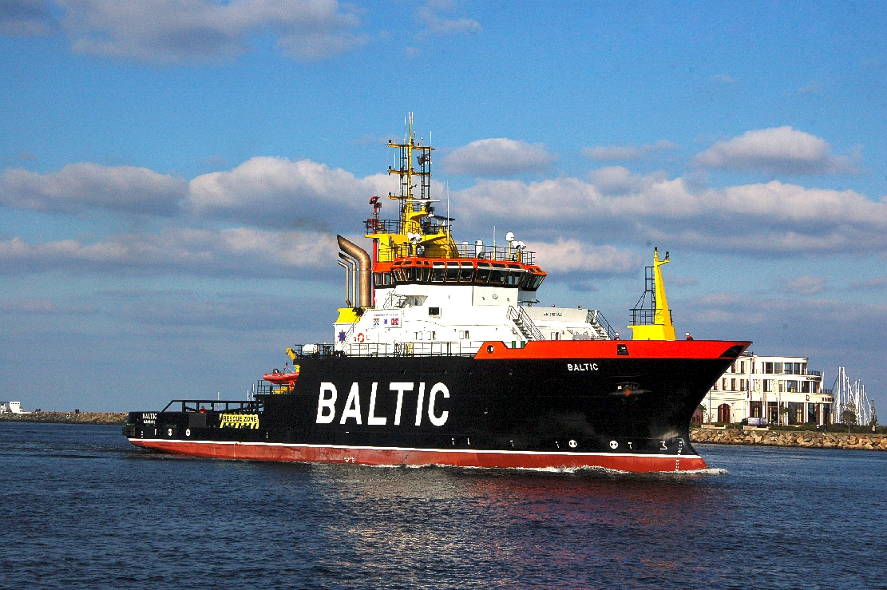
1. Motivation
Variety of vessels
80% of international trade
Masses of data
AIS
Sonar
Satellite
Images
https://www.vesselfinder.com/
Von Georg Wiora (Dr. Schorsch) - Self drawn with Inkscape, CC BY-SA 3.0, https://commons.wikimedia.org/w/index.php?curid=353385
https://mmmake.com/wp-content/uploads/2020/06/Satellit-iStock.jpg
Von Ra Boe / Wikipedia, CC BY-SA 3.0 de, https://commons.wikimedia.org/w/index.php?curid=14707885
Notes:
Big variety of vessels that operate everyday
80 % international trade done by vessels
All vessels and surroundings generate data (onboard sensor data, AIS, image, sonar, satellite)
There is a lot of potential in this data, but it is separated and multimodal
Ontologies help by providing a common conceptual model for data integration

Slide 3



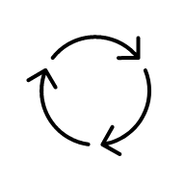
1. Motivation
Fleet Management and Operational Planning
Search and Rescue Operations
Standardization ←
Semantic Integration & Analysis
Digital Twins & Life Cycle Simulation
Contributions
AISHIP Ontology
48 CQs
Ontology evaluation for domain coverage
Notes:
These semantic data models can be utilized for use cases like
Route analysis
Anomaly detection
Vessel identification
All this in the bigger scope of the following usage scenarios
(Vessel identification, Route Analysis) Fleet Management and Operational Planning
(Vessel identification, Route Analysis) SAR Operations
Semantic integration & analysis → for cross-system analysis
(Anomaly detection) Digital Twins & Life Cycle Simulations
→ Standardization for digital twins of ships
Contributions
AISHIP Ontology
48 CQs
Ontology evaluation for domain coverage

Slide 4
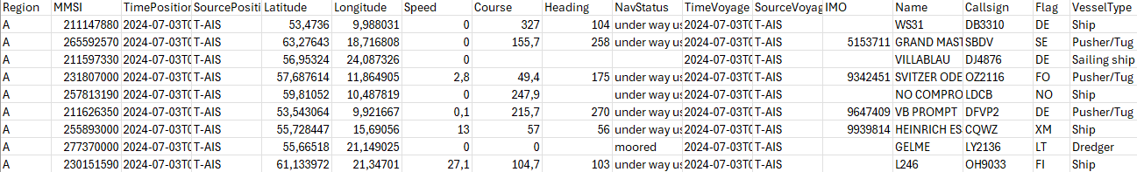
2. Ontology Development
SABiOx methodology (5 phases: Requirements, Setup, Capture, Design, Implementation)
During the Requirements Phase: CQs based on
→ the analysis of stakeholder requirements
Maritime experts with questions about relationships and components
→ the examination of specific use cases relevant to maritime operations, and the structure
Inspired by use cases (Fleet Management, SAR, Digital Twin)
→ content of a representative dataset on maritime vessels (e.g., AIS)
Notes:
Requirements
Define purpose
CQs (requirements)
Setup
Foundational ontologies for reuse
Capture
Identification of concepts and ontology modules
Design
Decisions for implementing the ontology (inclusion of vocabularies)
Implementation
- Implementation and made it available
During the Requirements Phase we designed CQs, based on
The analysis of stakeholde requirements (we had thorough discussions with maritime experts from the German SAR organization)
This way we identified relevant use cases
And we analyzed foundational datasets, like AIS-data
It was all about terminology and hierarchy
We did check backs with the experts
Short explanation:
AIS data is sent every few seconds and includes mostly positional and meta data of ships which is used for collision avoidance
More specific: name, flag, ID, long, lat, speed, course

Slide 5

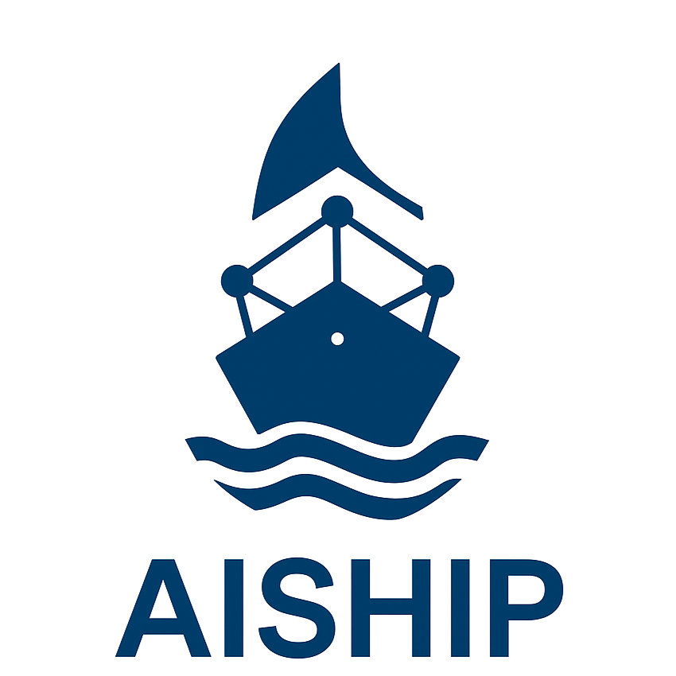
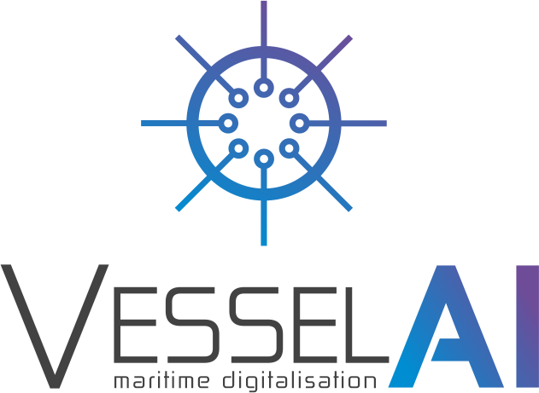


2. Ontology Development
Ontology: https://burbachs.github.io/AISHIPOntology/AISHIP.owl
GitHub: https://github.com/BurbachS/AISHIPOntology
License: CC BY-NC-SA 4.0
DOI: https://doi.org/10.5281/zenodo.16704863
Notes:
Based on these requirements we identified VesselAI as a valuable basis. (already covers many aspects: including trajectories, region modeling, basic ship identification properties)
We also introduced more ontologies and vocabularies, like
Schema → to cover real world entities things in the context of ships
QUDT → units
NEPOMUK (NFO, NEXIF) → ontology to express information extracted from various sources as well as image data
Published openly with persistent identifiers (DOI, GitHub)

Slide 6
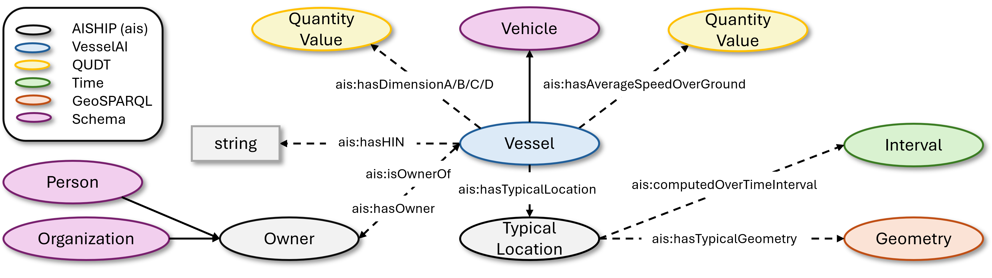
3. AISHIP – 1) Enhanced Vessel Characteristics
→ Adds HIN, owner, AIS antenna placement, typical location, avg. speed
Notes:
The first module we added consists of Enhanced Vessel Characteristics, including
HIN: for further identification of bigger ships
DimensionsABCD: which is the position of the AIS-Antenna on board
AverageSOG: as a calculated aggregated value based on all trajectories
Typical location of a vessel as a Geometry, covering a certain area
Owner of a ship
How is typical location modeled? → Points or Polygons, which are shaped by a probability distribution?

Slide 7
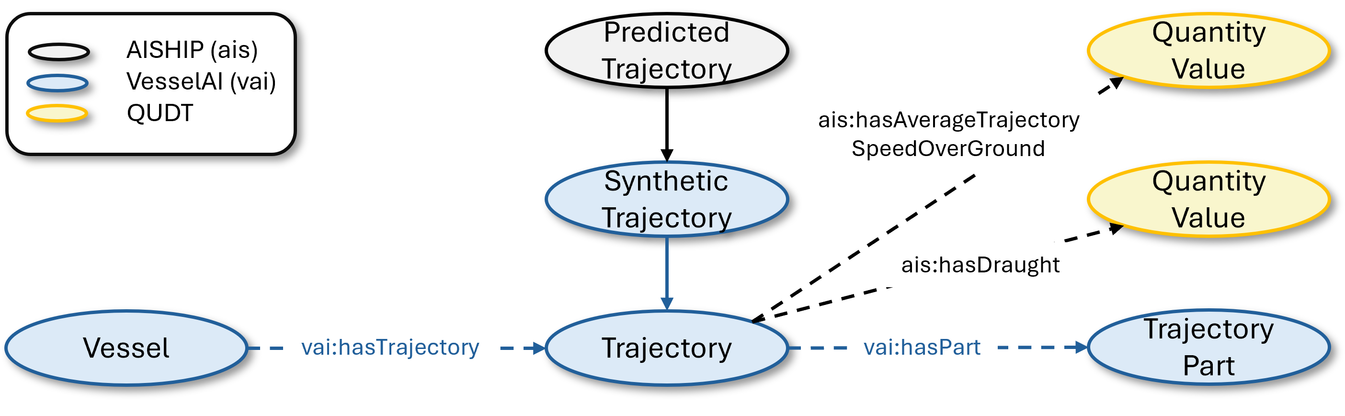
3. AISHIP – 2) Enhanced Trajectory Data
→ Adds draught, avg. trajectory speed, predicted trajectories
Notes:
Trajectories were modeld very nicely by VesselAI, by connecting every Positions sequentially with a „previous“ and „next“ property
We added a new trajectory class:
Predicted trajectory
For modeling predictions of routes for SAR operations
And added further details like
Average trajectory speed
Draught (as this indicates the loading state of a ship)

Slide 8
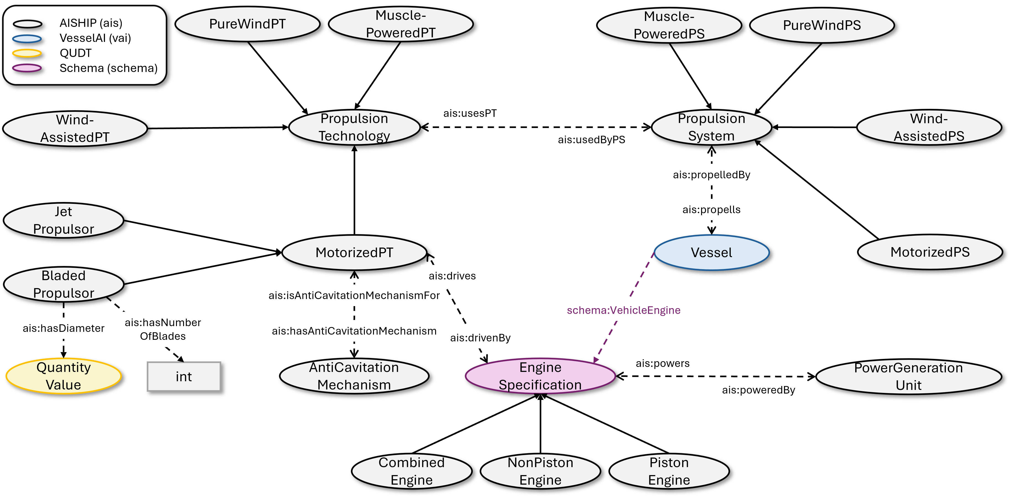
3. AISHIP – 3) Motorization & Propulsion
→ Detailed modeling of propulsion system with subtypes
Notes:
The main module we added consists of motorization and prompulsion systems.
We did it to form the basis for future extension. For now we only modeled the kind of propulsion types, like
Motorized
Wind assisted
Pure wind
Muscle powered
PS are depending on different PTs
Which can be sails
Rudders
Or sails used in combination with a motor
Motorized PTs divide into
Water or Gas Jets
Bladed propulsors, which are all kinds of propellers
These motorized PTs need an engine
- Which on their own have different types and fuels

Slide 9
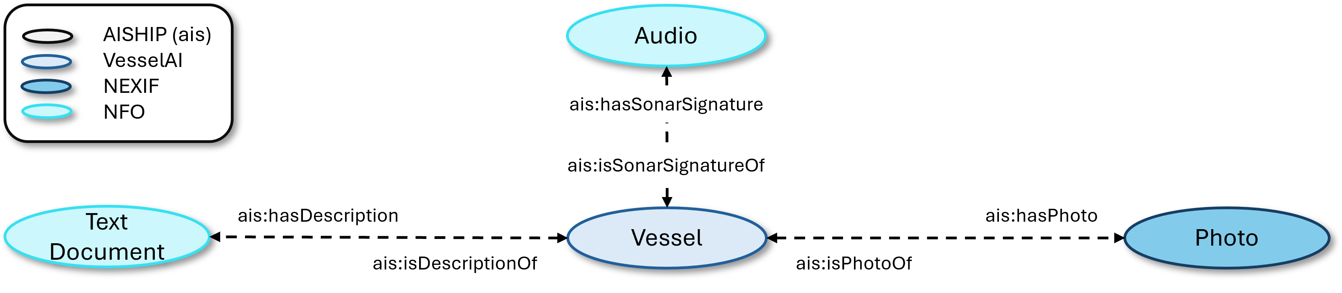
3. AISHIP – 4) Multimodal Representation
→ Vessels described by images, sonar signatures, text; with meta data for accuracy (e.g., capture and modification date)
Notes:
Our first module covered multiple properties to identify a ship, based on names, IDs, and shape
However a ship can be represented through
Textual descriptions
Photos
And audio signals, as every ship has a different sonar signature
→ Meta data includes
Storage directory/URL
Dates: Creation, change, authors

Slide 10
4. Restrictions
Data Types
Numerical values only as int/doubles etc. not as strings
Units
Speed: knots [kn]
Draught: meters [m]
T-Box Restrictions
Rules ensuring correct combination of propulsion types
Vessel with a pure wind propulsion system cannot utilize another propulsion system
Pure wind propulsion system cannot be utilized when vessel is wind assisted or purely motorized
Wind assisted propulsion system needs motorization and wind
Notes:
We also added different restrictions for
Data types (to make it less error-prone) and
Units
And also added T-Box restrictions, for example
That a vessel which is purely powered by wind cannot utilize another propulsion system
Wind assisted needs motor and wind propulsion

Slide 11
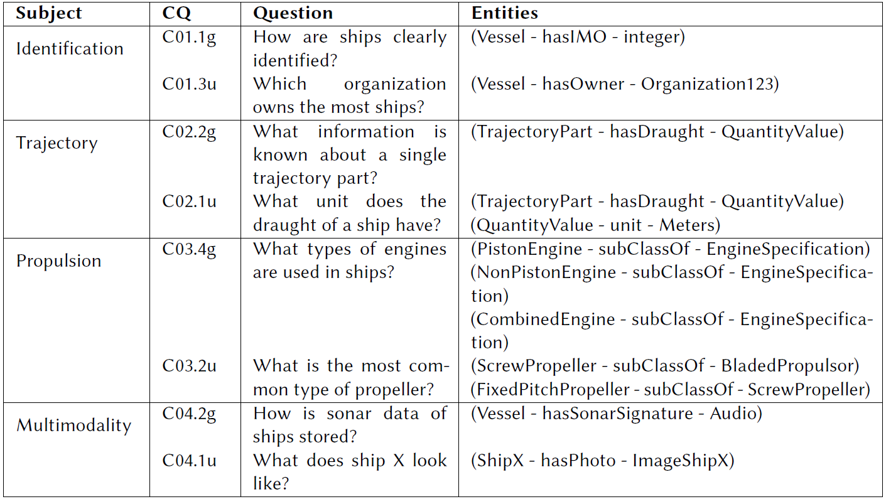
5. Evaluation
Verification: 48 CQs according to the modules
Achieves 100% coverage
Notes:
In terms of evaluating the implemented ontology, we only verified the coverage of 100%, based on the CQs for now.
(maybe explain the categorization of CQs)
general: structure and components (conceptual boundaries)
Use case: specific questions for concrete entities
Our goal is to also validate with ontology instances
And test, by running queries on the dataset
------------
Validation: SPARQL queries planned on representative dataset
Will include SHACL shapes for logical validation
Collaboration with maritime experts for real-world data integration
Goal:
Twofold evaluation
Verification (internal consistency)
Validation (real-world usefulness)

Slide 12
6. Limitations
CQs were not directly formulated by experts
They are based on
→ the analysis of stakeholder requirements
→ the examination of specific use cases relevant to maritime operations
→ content of a representative dataset on maritime vessels (e.g., AIS)
Only Motorization and Propulsion System types are described
→ Needs description of sensors, states, maintenance history etc.
Notes:
CQs were not directly formulated by experts.
They are “only” based on
the analysis of stakeholder requirements
the examination of specific use cases relevant to maritime operations, and the structure
content of a representative dataset on maritime vessels (e.g., AIS)
Only Motorization and Propulsion System types are described
Not enough for PHM
Needs description of sensors, states, maintenance history
→ for thorough maiantenance analysis and predictive health management
→ for now, we provide a valuable basis

Slide 13
6. Future Work
Future directions
Build extended dataset for validation
More quantitative metrics for evaluation
Apply in real-world context (e.g., trajectory prediction)
→ To prove ontology’s practical adequacy
Integrate sensor data (SSN/SOSA) for advanced use cases
e.g., fuel consumption estimation
Notes:
Conclusion: AISHIP closes semantic gaps of VesselAI by extending characteristics, trajectories, multimodal descriptions, and propulsion
(Ensures FAIR compliance and interoperability)
Build extended dataset to complete validation
With SHACL shapes
More quantitative metrics for evaluation, not just coverage
Apply in real-world context (e.g., trajectory prediction)
To prove that ontology has a practical use
Integrate sensor data (SSN/SOSA) for advanced use cases in the direction of PHM
E.g., fuel consumption estimation
Quantitative metrics
Structural metrics
Average depth
Average breadth (avg. Subclasses per class)
Inheritance richness (#subclass relations)/(#classes) → measures taxonomic richness (too low = unstructured; too high = redundant)
Relationship richness (#object properties/(#total properties) → ideal ontologies mix taxonomic and non-taxonomic relations
Attribute richness (#data properties)/(#classes) → describes how informative classes are
Semantic metrics
Consistency (use of reasoner) → check of logical modeling errors
Cohesion (average number of semanticall linked neighbors per class) → indicates semantic integration; extremes hurt clarity

Slide 14
References
United Nations Conference on Trade and Development (UNCTAD), Review of Maritime Transport 2024: Navigating Maritime Chokepoints, 2024. URL: https://unctad.org/publication/ review-maritime-transport-2024, accessed: 01.08.2025.
Z. Wang, C. Claramunt, Y. Wang, Extracting Global Shipping Networks from Massive Historical Automatic Identification System Sensor Data: A Bottom-Up Approach, Sensors 19 (2019) 3363. URL: http://dx.doi.org/10.3390/s19153363. doi:10.3390/s19153363.
Y. Yang, Y. Liu, G. Li, Z. Zhang, Y. Liu, Harnessing the power of Machine learning for AIS Data-Driven maritime Research: A comprehensive review, Transportation Research Part E: Logistics and Transportation Review 183 (2024) 103426. URL: http://dx.doi.org/10.1016/j.tre.2024.103426. doi:10.1016/j.tre.2024.103426.
International Maritime Organization (IMO), AIS Transponders, n.d. URL: https://www.imo.org/en/OurWork/Safety/Pages/AIS.aspx, accessed: 01.08.2025.
G. M. Santipantakis, C. Doulkeridis, G. A. Vouros, An Ontology for Representing and Querying Semantic Trajectories in the Maritime Domain, Springer Nature Switzerland, 2023, p. 224–237. URL: http://dx.doi.org/10.1007/978-3-031-42914-9_16. doi:10.1007/978- 3- 031- 42914- 9_16.
C. Claramunt, C. Ray, E. Camossi, A.-L. Jousselme, M. Hadzagic, A. Gennady, N. Andrienko, Y. Theodoridis, G. Vouros, L. Salmon, Maritime data integration and analysis: recent progress and research challenges, 2017. URL: https://openproceedings.org/2017/conf/edbt/paper-224.pdf.
doi:10.5441/002/EDBT.2017.18.
M. Mirović, M. Miličević, I. Obradović, Big Data in the Maritime Industry, Naše more 65 (2018) 56–62. URL: http://dx.doi.org/10.17818/NM/2018/1.8. doi:10.17818/nm/2018/1.8.
S. Brüggemann, K. Bereta, G. Xiao, M. Koubarakis, Ontology-Based Data Access for Maritime Security, Springer International Publishing, 2016, p. 741–757. URL: http://dx.doi.org/10.1007/978-3-319-34129-3_45. doi:10.1007/978- 3- 319- 34129- 3_45.
C. Ray, Data Variety and Integrity Assessment for Maritime Anomaly Detection, in: M.-R. Hojeij, B. Finance, Y. Taher, K. Zeitouni, R. Haque, M. Dbouk (Eds.), Proceedings of the 1st International Conference on Big Data and Cyber-Security Intelligence (BDCSIntell 2018), volume
2343 of CEUR Workshop Proceedings, CEUR-WS.org, Hadath, Lebanon, 2018, pp. 4–7. URL: https://ceur-ws.org/Vol-2343/paper3.pdf, accessed: 01.08.2025.

Slide 15
References
European Commission, ENABLING MARITIME DIGITALIZATION BY EXTREME‑SCALE ANALYTICS, AI AND DIGITAL TWINS, CORDIS Project Fact Sheet, 2023. URL: https://doi.org/10.3030/957237, Grant agreement ID 957237, coordinated by ETHNICON METSOVION POLYTECHNION, Greece.
R. Battle, D. Kolas, GeoSPARQL: Enabling a Geospatial Semantic Web, Knowledge EngineeringGroup, Raytheon BBN Technologies (2011) 1–17. URL: http://parliament.semwebcentral.org, accessed: 25.07.2025.
European Maritime Safety Agency (EMSA), Common Information Sharing Environment (CISE),2025. URL: https://www.emsa.europa.eu/cise.html, accessed: 27.07.2025.
A. Haller, K. Janowicz, S. Cox, D. L. Phuoc, K. Taylor, M. Lefrançois, Semantic Sensor Network Ontology, https://www.w3.org/TR/vocab-ssn/, 2017. W3C Recommendation, World Wide Web Consortium (W3C), accessed: 02.05.2025.
K. Janowicz, A. Haller, S. J. Cox, D. Le Phuoc, M. Lefrançois, SOSA: A lightweight ontology for sensors, observations, samples, and actuators, Journal of Web Semantics 56 (2019) 1–10. URL: http://dx.doi.org/10.1016/j.websem.2018.06.003. doi:10.1016/j.websem.2018.06.003.
G. Santipantakis, K. I. Kotis, G. A. Vouros, Ontology-Based Data Integration for Event Recognition in the Maritime Domain, in: Proceedings of the 5th International Conference on Web Intelligence, Mining and Semantics, WIMS ’15, ACM, 2015, p. 1–11. URL: http://dx.doi.org/10.1145/2797115.2797133. doi:10.1145/2797115.2797133.
C. Z. Aguiar, V. E. S. Souza, SABiOx: the extended systematic approach for building ontologies, in: Proceedings of the 17th Seminar on Ontology Research in Brazil (ONTOBRAS 2024) and 8th Doctoral and Masters Consortium on Ontologies (WTDO 2024), CEUR Workshop Proceedings, Vitória, Brazil, 2024. URL: https://nemo.inf.ufes.br/projetos/sabiox, Available under Creative Commons License Attribution 4.0 International (CC BY 4.0).
A. Gangemi, V. Presutti, Ontology Design Patterns, Springer Berlin Heidelberg, 2009, p. 221–243. URL: http://dx.doi.org/10.1007/978-3-540-92673-3_10. doi:10.1007/978- 3- 540- 92673- 3_10.
E. Blomqvist, A. Gangemi, V. Presutti, Experiments on pattern-based ontology design, in: Proceedings of the fifth international conference on Knowledge capture, K-CAP ’09, ACM, 2009, p. 41–48. URL: http://dx.doi.org/10.1145/1597735.1597743. doi:10.1145/1597735.1597743.

Slide 16
References
International Maritime Organization (IMO), Reduction of GHG Emissions from Ships: Wind Propulsion, Technical Report MEPC 79/INF.21, Marine Environment Protection Committee, 79th session, 2022. URL: https://www.wind-ship.org/archived-site/wp-content/uploads/2022/10/MEPC-79-INF.21-Wind-Propulsion-Finland-France-Saudi-Ar....pdf, accessed: 01.08.2025.
N. Kornev, Propellertheorie, Universität Rostock, Fakultät für Maschinenbau und Schiffstechnik, Rostock, Germany, 2009. URL: https://www.yumpu.com/de/document/read/8864664/prof-dr-ing-nikolai-kornev-lehrstuhl-fur-modellierung-und-, accessed: 01.08.2025.
S. Jörke, Konzeptentwicklung für den Entwurf von Schiffspropellern, Diplomarbeit D 2057, Technische Universität Dresden, Fakultät Maschinenwesen, Institut für Strömungsmechanik, Professur für Turbomaschinen und Flugantriebe, Dresden, Germany, 2017. URL: https://cfturbo.com/fileadmin/content/down/publications/students/2017-07-Soeren-Konzept-Entwurf-Schiffspropeller.pdf, accessed: 01.08.2025.
I. Krmek, V. Mrzljak, I. Poljak, Analysis and Comparison of Ship Propulsion Systems, Pomorskizbornik 62 (2022) 75–95. URL: https://hrcak.srce.hr/file/408027, Review article, received: 9 May 2022, accessed: 01.08.2025.
S. Giorgos, D. Christos, V. George, Linked open data for the maritime domain, 2022. URL: https://zenodo.org/record/6608427. doi:10.5281/ZENODO.6608427.
S. Burbach, L. Mackert, M. Maleshkova, BurbachS/AISHIPOntology: AISHIP v1.0.0: Prepublication release, 2025. URL: https://github.com/BurbachS/AISHIPOntology. doi:10.5281/zenodo.16704863.

Slide 17


Title
Thank you!
Simon Burbach
simon.burbach@hsu-hh.de
Lennart Mackert
lennart.mackert@hsu-hh.de
Maria Maleshkova
maria.maleshkova@hsu-hh.de
Data Engineering
Helmut Schmidt University

